Slide 1

Introduction Big Data
TK13025
PROGRAM STUDI TEKNIK INFORMATIKA
UIVERRSITAS TARUMANAGARA

Slide 2

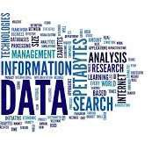
Big Data → Data Concept
What is ‘Data’ ?!
5min to answer…

Slide 3













Big Data → Data Concept → Data
Data
Are the raw facts (or descriptions of facts) that were taken, observed, recorded, agreed, such as words, numbers, observations, surveys, etc.
Data are unprocessed facts, figures, schemas, etc.
In Information Systems (Computerized), Data is the input in the computer system.
Data doesn’t have a meaning !
Data
Sources

Slide 4

Big Data → Data Concept → Data
Data
2 kinds of Data :
Qualitative: textual or symbolic
Quantitative: numerical
Quantitative |  | Qualitative
Concept/Definition | Valuated facts | Describted facts
Methodology | Collected by | Collected by
 | measurement tools | observation
Analysis | Performed by statistical and numerical methods | Perfomed by specific adapted methods of classification, quantification, etc.
Results | Reported through statistic methods | Reported through a specific format/language

Slide 5






Big Data → Data Concept → Data
Data
Example
Meaning
What context ?
Temperature of what ?
24°
Data

Slide 6







Big Data → Data Concept → Information
Information
Is the raw fact that was taken, observed, recorded, agreed.
Information is processed
Processed Data become information.
Information is based on Data
Data
Data
Data
Processing
Information

Slide 7
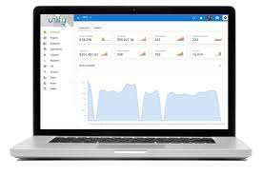






Big Data → Data Concept → Information
Information
Example
24° is
The Temperature of weather
In Strasbourg
• On 13/01/2019
24°
Information
Data

Slide 8











Big Data → Data Concept → Knowledge
Knowledge
Is the set of relationships between information elements following an ontology
Mapped information: how they are related, what is compound in what, where ?
There is ontology (definition of meanings) that frame the set of information
Data
Data
Data
Processing
Information
Information
Information
 | Ontology
Mapping

Slide 9

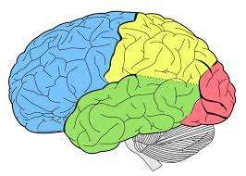


Big Data → Data Concept → Knowledge
Knowledge
Example
24° is
The Temperature of weather
In Strasbourg
• On 13/01/2019
Information
Knowledge
24°
Data
Decision:
Go out for a cruise

Slide 10
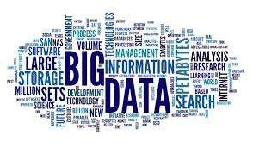
Big Data → Big Data Concept
What is ‘Big Data’ ?!
5min to answer…

Slide 11
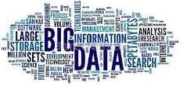
Big Data → Big Data Concept
Analyze
Volume
Market
Analytics
Management
Model
Variety
Web
Facebook

Slide 12
Big Data → Big Data Concept
Definition
Big Data is the field that gathers all activities and functions of :
Acquisition of Data,
Storage of Data.
from multiple sources that cannot be processed by common and traditional systems (for example ERP, Excel, etc.).
In Big Data, Data are :
4 V
Huge(Volume),
hetereougenious (Variety),
-
-
Dynamic (Velocity), Uncertain (Veracity).

Slide 13
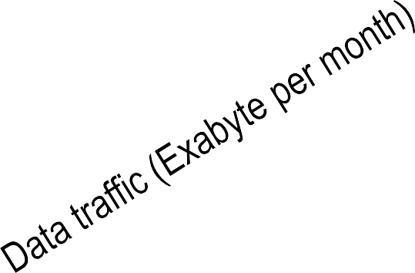
Big Data → Big Data Concept → Volume
Volume
The evolution of data stored and exchanged over time.
16.5
11.2
7.4
4.7
2.8
1.6
0.9
2012
2013
2014
2015
2016
2017
2018

Slide 14


Big Data → Big Data Concept → Volume
Volume
The evolution of data stored and exchanged over time.
X 1024
X 1024
X 1024
X 1024
8 bits
Byte
KB
MB
GB

Slide 15

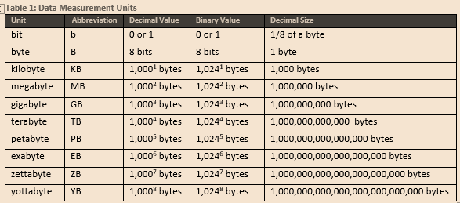
Big Data → Big Data Concept → Volume
Volume
The evolution of data stored and exchanged over time.
Data Measurement Units
Unit | Abbreviation | Decimal | Binary | Size

Slide 16
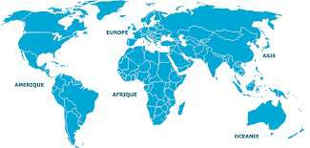
Big Data → Big Data Concept → Volume
Volume
Distribution of Data centers around the world.
North America: 45%
Europe : 32%
Middle East : 2%
Isles : 8%
Asie : 10%
South America: 2%
Africa : 1%

Slide 17
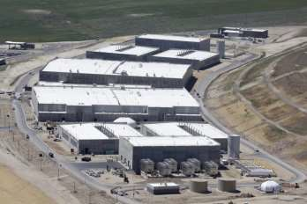
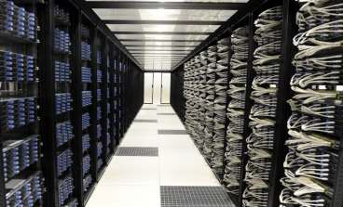
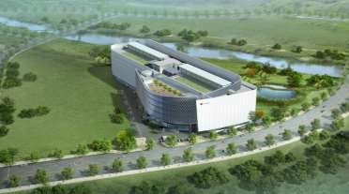
Big Data → Big Data Concept → Volume
Volume
Multiple Data centers around the world.
Data Center Utah (USA)
Data Center Vitry (France)
Data Center Busan (South Korea)

Slide 18


Big Data → Big Data Concept → Volume
Volume
Storage price decreasing.

Slide 19
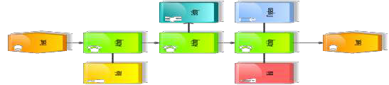





Big Data → Big Data Concept → Volume
Volume
Virtualization.
Cloud Computing
Managers
Finances
Customers
Developers
Help Desk
Users

Slide 20


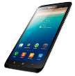






Big Data → Big Data Concept → Volume
Volume
Internet Of Things.

Slide 21





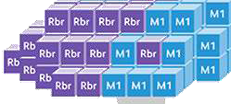
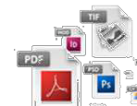


Big Data → Big Data Concept → Variety
Variety
No standard format of data in storages. Meta-Data of structures and organizations, semantic Data, images, videos, texts, XML, text formats, etc.

Slide 22








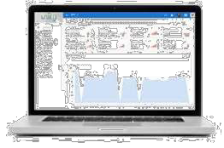




Big Data → Big Data Concept → Variety
Variety
Different sources.

Slide 23





Big Data → Big Data Concept → Variety
Variety
Structured and unstructured Data.
Raws
Fields
Data Base System
Name
Year
Number ID
Address
Alfred Bane
1980
5467364225
1 str Rest X
67000 Strg
Alfred Bane
1980
5467364225
1 str Rest X
67000 Strg
Alfred Bane
1980
5467364225
1 str Rest X 67000 Strg
Corporate transactions
Reports
Other data bases files
Tables

Slide 24





Big Data → Big Data Concept → Variety
Variety
Structured and unstructured Data.

Slide 25
Understanding Big Data
A. Concepts and Terminology
Datasets
Data Analysis
Data Analytics
B.Big Data Characteristics

Slide 26
Figure 1.1 Datasets can be found in many different formats.

Slide 27
Figure 1.2 The symbol used to represent data analysis.
Figure 1.4 Value and complexity increase from descriptive to prescriptive analytics.

Slide 28
The operational systems, pictured left, are queried via descriptive analytics tools to generate reports or dashboards, pictured right.

Slide 29
Diagnostic analytics can result in data that is suitable for performing drill-down and roll-up analysis.

Slide 30
Predictive analytics tools can provide user-friendly front-end interfaces.

Slide 32
Prescriptive analytics involves the use of business rules and internal and/or external data to perform an in-depth analysis.

Slide 33
BI can be used to improve business applications, consolidate data in data warehouses and analyze queries via a dashboard.

Slide 34
A KPI dashboard acts as a central reference point for gauging business performance.

Slide 35
Big Data Characteristics

Slide 36
Volume

Slide 37
Velocity

Slide 38
Variety

Slide 39
Value

Slide 40
Different Types of Data

Slide 41
Thank You
Reference: Database Systems A Practical Approach to Design, Implementation, and Management Fourth Edition.
Thomas M. Connolly and Carolyn E. Begg

